Slide 1
Engine Control System

Slide 2
Introduction to system
A system is a set of interacting or interdependent components forming an integrated whole
  A system has structure, it contains parts (or components) that are directly or indirectly related to each other;
  A system has behavior, it contains processes that transform inputs into outputs (material, energy or data);
  A system has interconnectivity: the parts and processes are connected by structural and/or behavioral relationships.
  A system's structure and behavior may be decomposed via subsystems and sub-processes to elementary parts and process steps. (“Divide and Conquer”)
Elements of a system :
  Inputs and outputs
  Processor
  Control
  Environment/surroundings
  Feedback
  Boundaries and interface

Slide 3
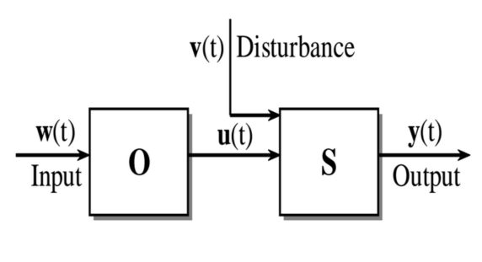

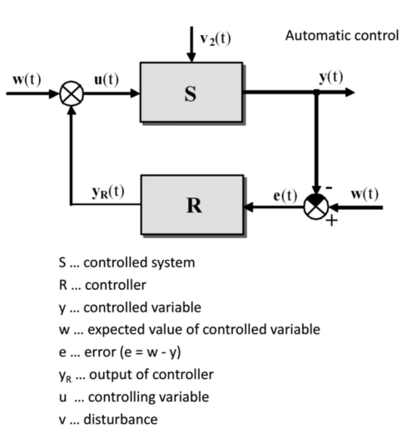
Introduction to system
Open-Loop
  Simple control system which performs its function without concerns for initial conditions or external inputs
  Must be closely monitored
  the input has no way to compensate the variation in the system…
Closed-Loop (feedback)
  Uses the output of the system to modify the input to produce the desired result
  Continually adjusts the input

Slide 4
Introduction to control system
Control system – mechanism that alters the future state or behavior of the system.
Behavior or the output must tent towards the state which is desired
Control theory – branch of mathematics to find a strategy to select appropriate input ….
Without CT finding this strategy is simple trial and error
How do I change the input to get desired output.
Desired output….
System / or a plant

Slide 5
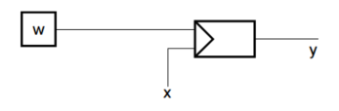
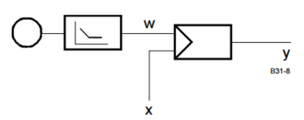
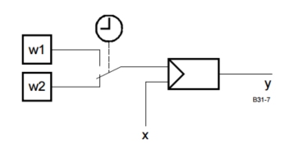
Types of control
Fixed set point control
  The reference variable w is set as a fixed setpoint x at the controller's set point selector
  ACC without climate control
Follow up control
  The reference variable is varying in time depending on other variables however its progress in time is not known before
    Automatic climate control
Program control
  Time behavior of expected value is programmed
    Example: Central heating control
    Radar antenna control

Slide 6

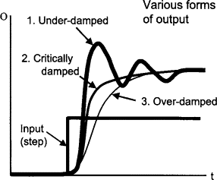
Types of responses
Transient Response
  The transient response is the temporary part of the solution. It represents the system's reaction to an abrupt change (like flipping a switch or applying a sudden force)
Steady-state response
  long-term behavior of a system after it has been subjected to an input for a long enough time that all temporary, startup effects have disappeared.
  It's the stable, long-term behavior after the initial Transient response has died out. For a closed-loop system, it describes the final, settled relationship between the output and the input.
Dynamic response
  Is the complete, time-varying behavior that occurs immediately following a change in its inputs or environment.
  Essentially, the dynamic response is the entire journey a system takes from its initial state to its final steady state.
  Dynamic Response (y(t))=Transient Response (ytransient (t))+Steady-State Response

Slide 7
Step test / step response
The dynamics of a process can be determined from the response of the process to pulses, steps, ramps, or other deterministic signals.
Many tuning methods are based on it.
Step Test procedure:
  Wait until the process is at rest.
  Set the controller to manual.
  Change the control variable rapidly *,
  Record the process variable and scale it by dividing by the change in the control variable.
* The change in control variable should be as large as possible in order to get a maximum signal to noise ratio.

Slide 8
PID controller
PID – Proportional Integral derivative
Describes how the error terms is handled (how to correct an input based on error)
Kp, Ki, Kd – are gain which can be changed (adjusted)
Proportional multiplied by Kp
Controller output
Error
Integral multiplied by Ki 1/s and integrated
Integral multiplied by Kd *s and differentiated

Slide 9
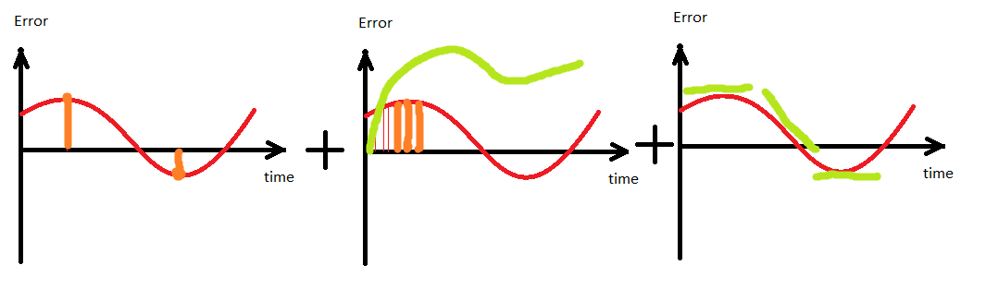
PID Controller part 2
Proportional path remove current error get to desire output as soon as possible
Integral path is used to remove constant errors in the control system, no matter how small the constant error, the summation will by significant enough to adjust controller output
Derivative path – the rate of change which contributes to the output signal. , limits you to over shoot desired output
Look at home: https://www.youtube.com/watch?v=XfAt6hNV8XM&feature=iv&src_vid=UR0hOmjaHp0&annotation_id=annotation_891845

Slide 10
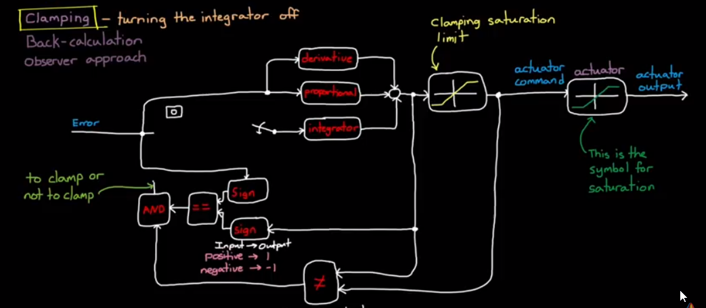
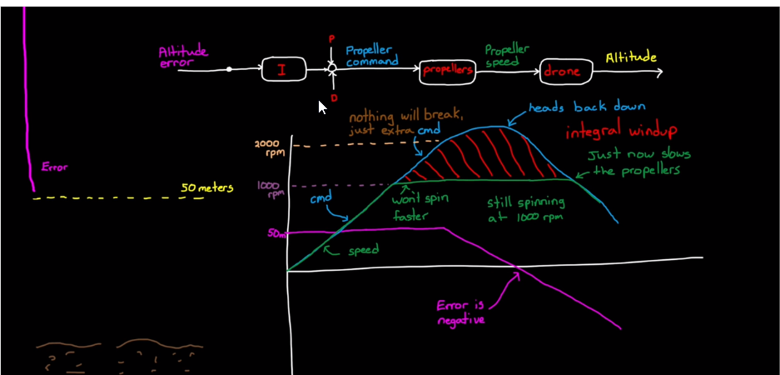
Notes:
https://www.mathworks.com/videos/understanding-pid-control-part-2-expanding-beyond-a-simple-integral-1528310418260.html

Slide 11
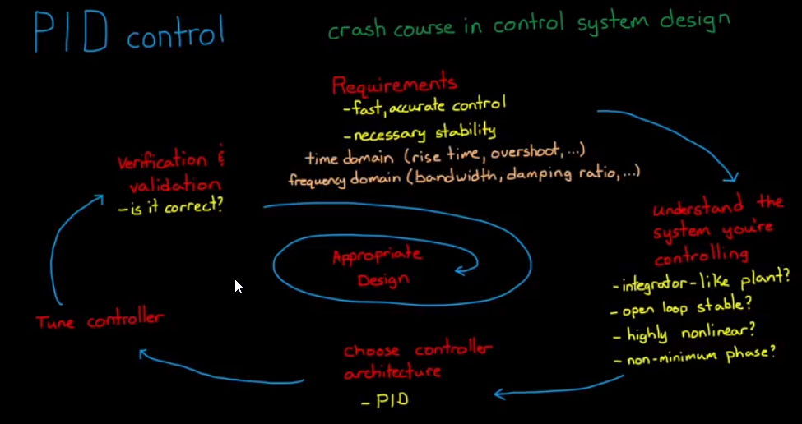

Slide 12
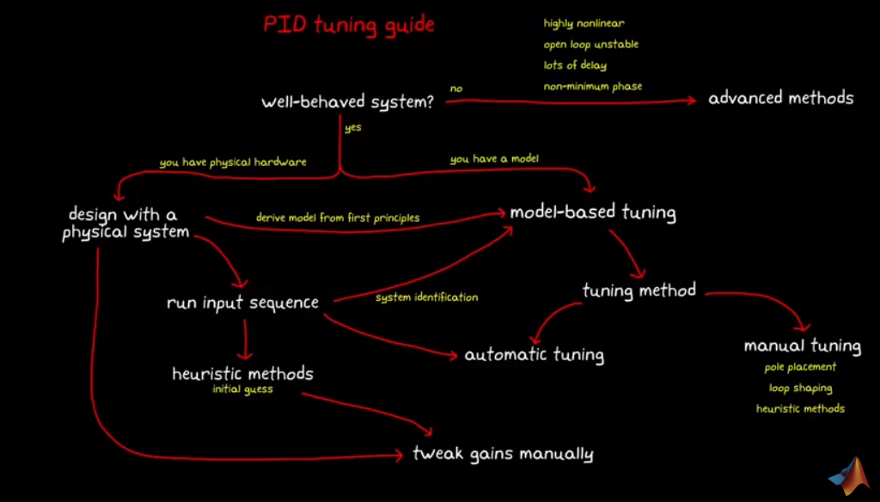
PID Tuning
The process of setting the optimal gains for P, I and D to get an ideal response from a control system is called tuning
A lot of different Methods
  Guess And Check
  Ziegler-Nichols
  Cohen-Coon Method
  Tyreus-Luyben Method
  Autotune Method

Slide 13
Guess And Check
Set
Set all gains to zero.
Increase
Increase the P gain until the response to a disturbance is steady oscillation.
Increase
Increase the D gain until the the oscillations go away (i.e. it's critically damped).
Repeat
Repeat steps 2 and 3 until increasing the D gain does not stop the oscillations.
Set
Set P and D to the last stable values.
Increase
Increase the I gain until it brings you to the set point with the number of oscillations desired

Slide 14
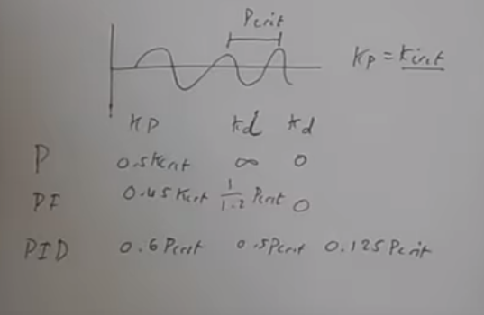
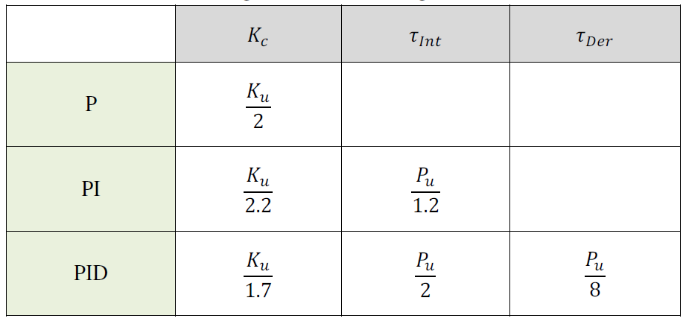
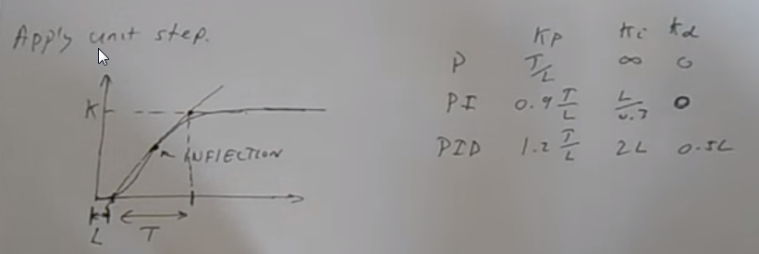
Ziegler-Nichols
Determine the sign of process gain Implement a proportional control and introducing a new set-point.
Increase proportional gain until sustained periodic oscillation.
Record critical gain and ultimate period (Ku Pu)
Evaluate control parameters as prescribed by Ziegler and Nichols
https://www.youtube.com/watch?v=nvAQHSe-Ax4

Slide 15
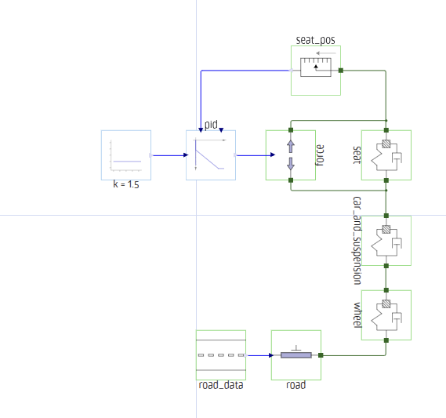
Practical task
Study the system below
Implement ZN method to find suitable PID constants.

Slide 16
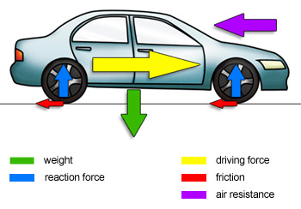

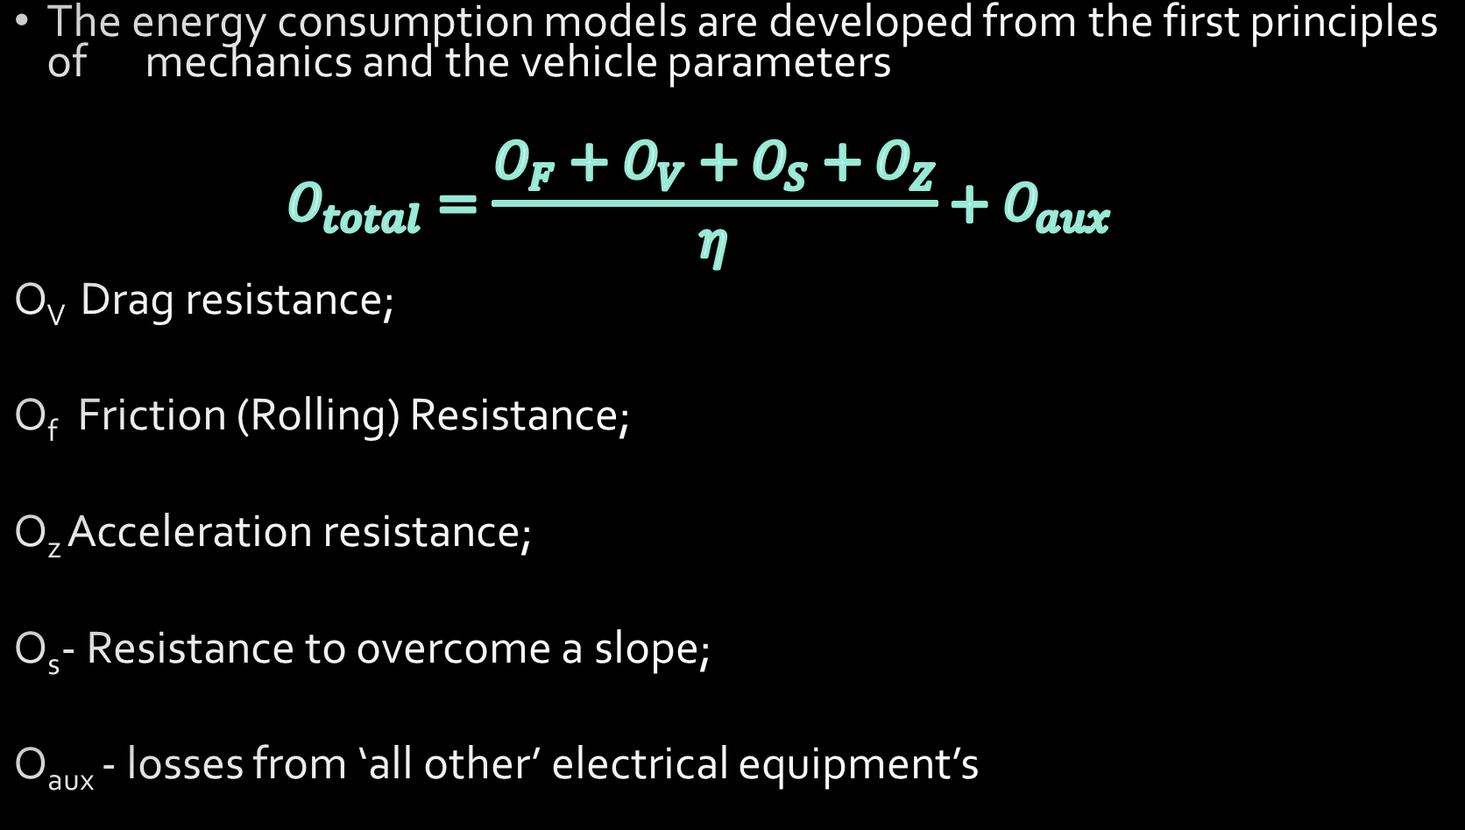



Energy used by vehicle
The energy consumption models are developed from the first principles of mechanics and the vehicle parameters
  $$O_{total}=\frac{O_{F}+O_{V}+O_{S}+O_{Z}}{η}+O_{aux}$$
O_{V} Drag resistance;
O_{f} Friction (Rolling) Resistance;
O_{z} Acceleration resistance;
O_{s}- Resistance to overcome a slope;
O_{aux} - losses from ‘all other’ electrical equipment’s
$$O_{v}=\frac{1}{2} ρ∙c_{x}∙S_{x}∙{\left(v−v_{wind}\right)}^{2}$$
$$O_{f}=m∙g∙f_{k}∙\cos{α}$$
$$O_{z}=m∙a∙v$$
$$O_{s}=m∙g∙v∙\sin{α}$$
$$O_{aux}=O_{climat}+O_{batmngm}+O_{light}+O_{audio}$$

Slide 17
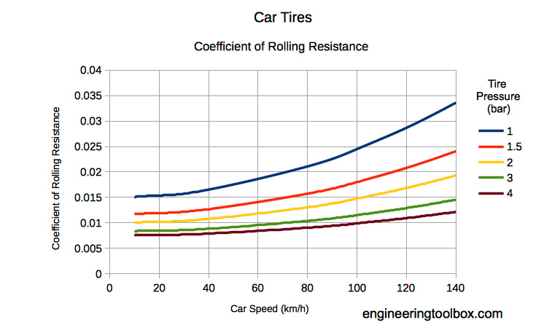
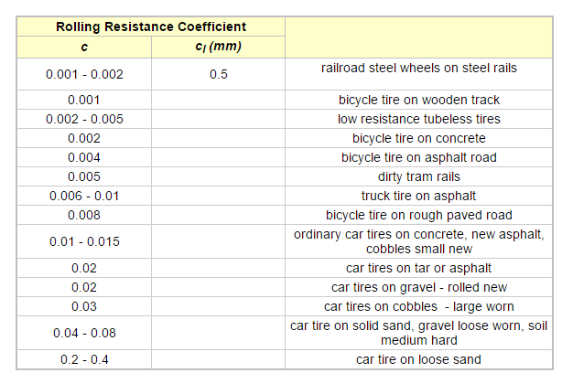
Rolling resistance coefficient

Slide 18
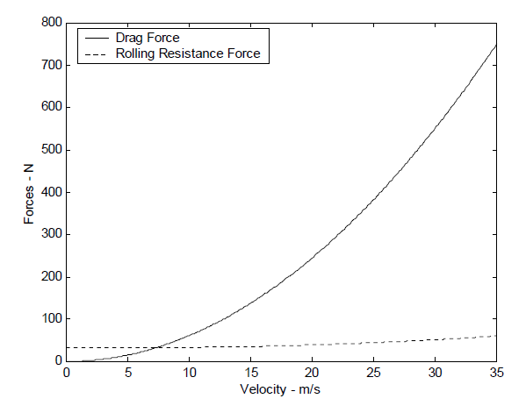
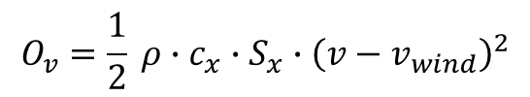

$$O_{v}=\frac{1}{2} ρ∙c_{x}∙S_{x}∙{\left(v−v_{wind}\right)}^{2}$$
$$O_{f}=m∙f_{k}$$

Slide 19
Internal Combustion Engine
It is an engine which converts chemical energy of fuel into mechanical energy by burning the fuel inside the engine cylinder.
Based on the fuel used
  Diesel Engine
  Petrol Engine (or Gasoline Engine)
Based on the type of cycle
  Otto Cycle Engine
  Diesel Cycle Engine
  Dual Cycle Engine
Based on the number of strokes per cycle
  Two-stroke Engine
  Four-stroke Engine
Based on the number of cylinders
  Single Cylinder Engine
  Multi cylinder Engine
  Twin Cylinder Engine
  …
Based on the type of ignition
  Spark Ignition Engine (S.I. Engine)
  Compression Ignition Engine (C.I. Engine)
Based on the cooling system used
  Air-cooled Engine
  Water-cooled Engine
Notes:
Internal combustion means just what it says: that fuel is burned inside the engine. In a car engine, gasoline is burned inside the engine, which ignites the fuel and releases energy that moves the car.
There are also other methods of internal combustion, such as diesel engines and gas turbine engines.
Internal combustion is an efficient system that requires a relatively small engine to create motion.
It is also more fuel efficient than external combustion engines, such as an old-fashioned steam engine.
Gasoline engines used to be as inefficient as steam engines.
a two-stroke engine, the end of the combustion stroke and the beginning of the compression stroke happen simultaneously, with the intake and exhaust (or scavenging) functions occurring at the same time. https://www.youtube.com/watch?v=Z6YC3I54so4
In 1876 (Gottlieb Daimler
) the gasoline engine was invented and it was no more efficient than the steam engine, which used external combustion. A lot of fuel was wasted. In 1878, Rudolph Diesel decided to develop an engine with higher efficiency, and in
1892 the diesel engine was born. It was more efficient as an internal combustion engine, but it took many more years to develop a diesel engine that was cleaner and quieter.

Slide 20
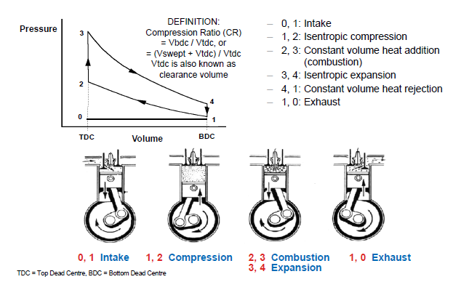
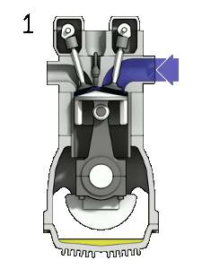
Otto-Cycle
Notes:
Engines based on the four-stroke ("Otto cycle") have one power stroke for every four strokes (up-down-up-down) and employ spark plug ignition. Combustion occurs rapidly, and during combustion the volume varies little ("constant volume").^{[8]} They are used in cars, larger boats, some motorcycles, and many light aircraft. They are generally quieter, more efficient, and larger than their two-stroke counterparts.
Most truck and automotive diesel engines use a cycle reminiscent of a four-stroke cycle, but with a compression heating ignition system, rather than needing a separate ignition system. This variation is called the diesel cycle. In the diesel cycle, diesel fuel is injected directly into the cylinder so that combustion occurs at constant pressure, as the piston moves.

Slide 21
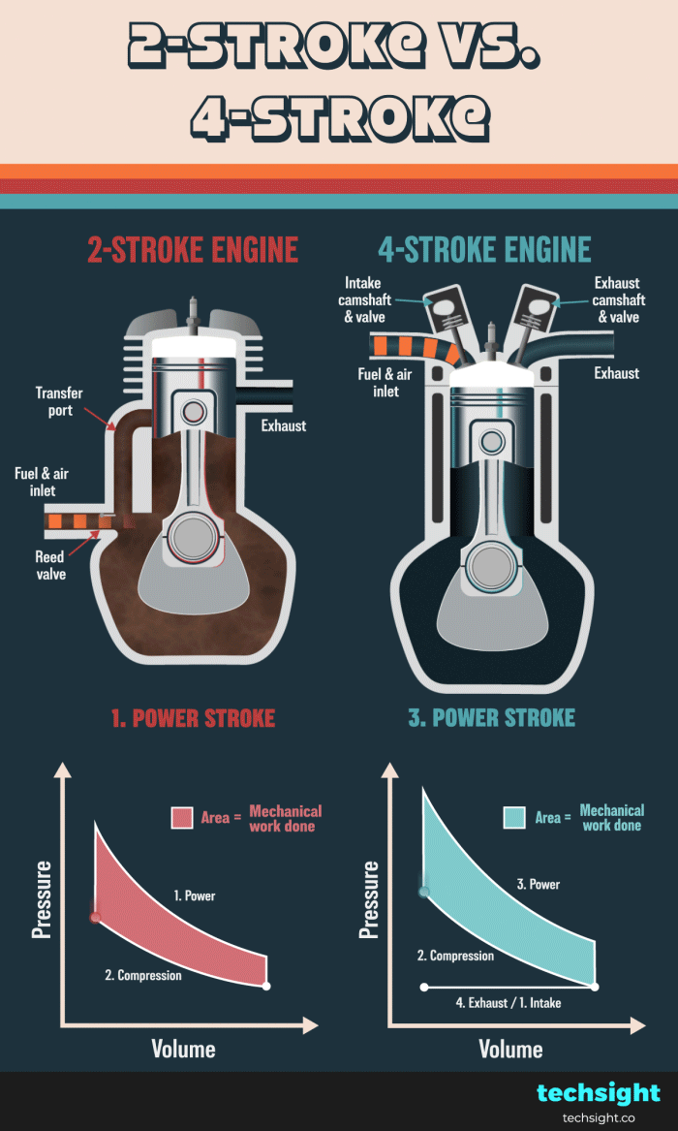

Slide 22
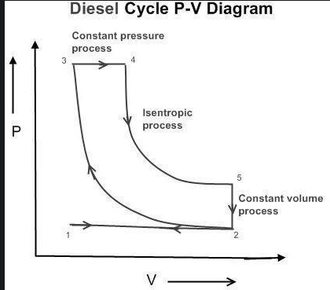
Diesel-cycle
Can operate with a higher compression ratio , only air is compressed and there is no risk of auto-ignition of the fuel
Fuel is sprayed into the cylinder at $ P_2$ (high pressure) when the compression is complete, and there is ignition without a spark.
1-2 In this process suction takes place
2-3 (Adiabatic process) In this process compression takes place. Both the inlet and exhaust valves are closed and the compression takes place which is much higher than that of an otto cycle. This increases the pressure and temperature.
3-4 (Isobaric process) In this process, fuel is added, and combustion occurs due to high temperature, while maintaining a constant pressure because the volume is also increasing.
4-5 (Adiabatic process) In this process expansion takes place, due to combustion the piston moves from TDC to BDC and power is generated.
5-2 (Isochoric process) In this process, heat rejection is taking place at constant volume.
Notes:
https://youtu.be/DZt5xU44IfQ?t=88

Slide 23
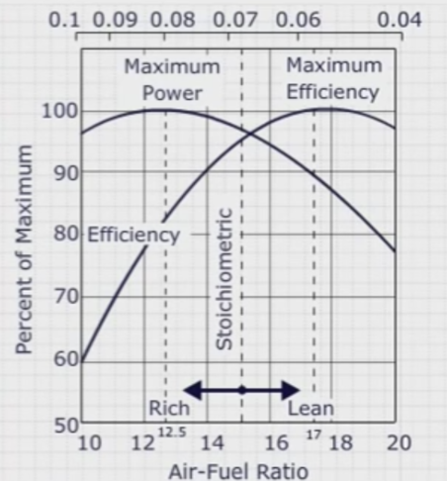
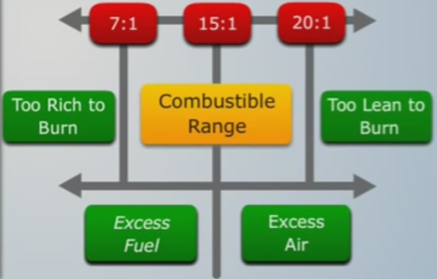
ICE
Principles:
  Law of conservation of Energy
    It states: that the total energy of an isolated system cannot change—it is said to be conserved over time. Energy can be neither created nor destroyed, but can change one type to another.
  Chemical energy of Fuel/Air Mixture is converted to kinetic energy in the explosion
  A lot of loss due to these transformations 37 % efficiency
Stoichiometric Fuel/Air Mixture
  An "ideal" fuel/air mixture in which both the fuel and the oxygen in the air are completely consumed (14.6) Used only for “idle run”
  To increase power we need to make FA mixture “Rich”
  When we don’t need power to save fuel, “Chip” FA mixture is used
Notes:
https://www.youtube.com/watch?v=h5Ug-U-Rsts&ab_channel=TutorialsPoint%28India%29Ltd.

Slide 24
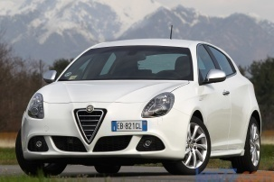
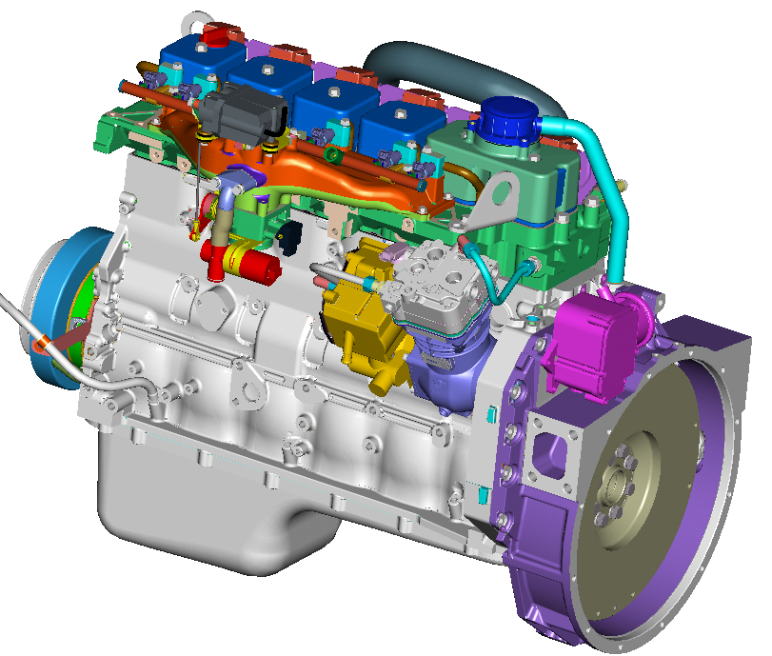
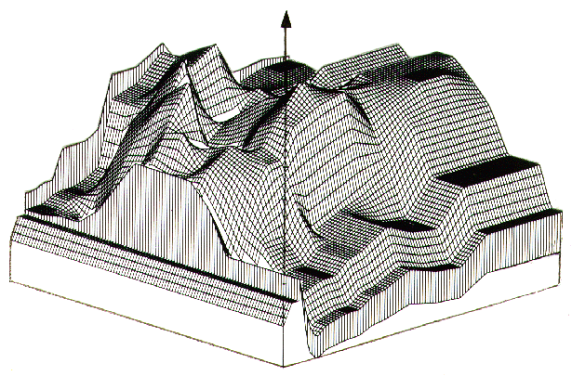
Engine Control System
Other vehicle system’s control
A control system is a device, or set of devices, that manages, commands, directs or regulates the behavior of other device(s) or system(s)
The engine control system includes:
  sensors for the detection of the engine operating modes
  electronic control unit (ECU) which elaborates the signal values supplied by the sensor, according to defined control strategies and algorithms, and defines the actions to be delivered to the actuators
  actuators which have the task to actuate the defined commands
ECU
SENSORS
ACTUATORS
Notes:
~adjust the fuel injection and ignition timing
~ Speek about ecology (additional sensors)

Slide 25
Engine Control system functions
Ensures that the driver request is implemented (Desired torque)
  minimise exhaust emissions and fuel consumption
  optimal driveability for all operating condition
    No stalls, hesitations or other objectionable roughness should occur under vehicle operation.
  the idle speed control,
  minimise evaporative emission
    EGR (Exhaust gas recirculation) control and
    evaporative emissions control.
  provide system diagnosis when malfunctions occur

Slide 26
How these is achieved
Determines precisely how much fuel needs to be delivered by the injector by monitoring the engine sensors.
Turns the injectors on for a precise amount of time and at precise time interval to deliver fuel so that the proper air/fuel ratio is delivered to the engine
Regulates spark advance angle by monitoring engine operating conditions, calculating the optimum spark timing, and firing the spark plug at the appropriate time.
Modern vehicles also regulate when and how to open intake and exhaust valves as well

Slide 27
Subsystems
Starting systems
  Accelerate an engine to some speed, so that it sucks fuel and air into the cylinders, and compresses it
Cooling Systems
  Heat up as soon as possible and keep a constant working engine temperature
Ignition system
  Generate a very high voltage from the car's 12 volt battery, and to send this to each sparkplug in turn, igniting the fuel-air mixture in the engine's combustion chambers.
Fuel injection system
  Delivered a proper amount of fuel from fuel tank to the pistons
Evaporation and exhaust systems
Charging system
  Produce a constant Voltage to power vehicle equipment and charge the battery
Diagnostic systems
  Control a status and state of all subsystems and their components
  Provide visual warnings for drivers if there is a failure in the system

Slide 28
Control strategy.
Cranking
  To get the engine started with the minimal amount or delay
  To minimize the exhaust emissions (during crank the catalyst is cold and its efficiency is very low).
Warm-Up
  Keep the engine operating smoothly (i.e. no stalls or driveability problems),
  Increase exhaust temperature to quickly achieve operational temperature for catalyst (light-off) and lambda sensor so that close-loop control can begin operating,
  Keep exhaust emissions and fuel consumption to a minimum
Cut-off
  During deceleration, such as coasting or braking
Idling
  Achieving a consistent idle speed even with various load changes due to accessories
  Provide the lowest idle speed that allows smooth running to achieve the lowest exhaust emissions and fuel consumption
Normal
  Engine work in steady state condition (i.e. without sensible variation of load and speed)
    Acceleration Enrichment (fuel mixture richness is required)
    Deceleration Enleanment (inverse than in acceleration)
Engine and vehicle speed limitation
  limiting RMP and speed variables with fuel cut-off

Slide 29
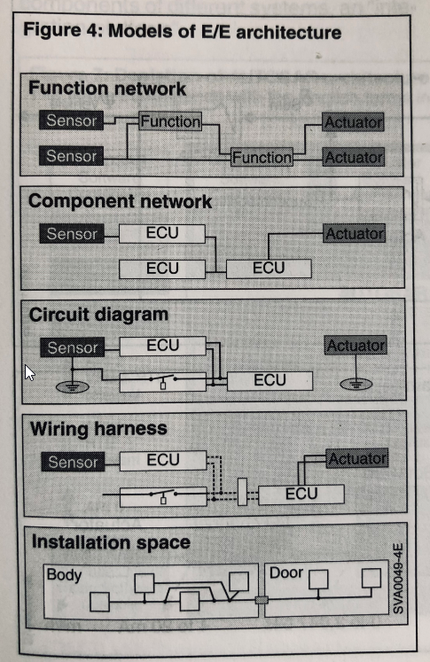
Models of Electrical and Electronic architecture
Functional – preliminary stage, signal flow diagram
Component network
  Technology model
  Node model
  ECU hardware model
  ECU software module
  Network model and communication
Circuit diagram
Wiring harness and space

Slide 30
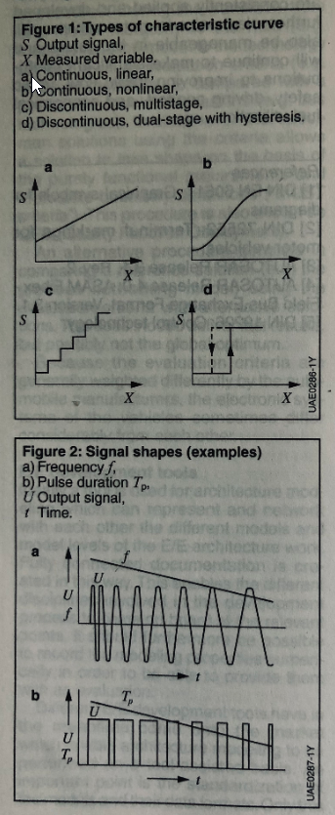
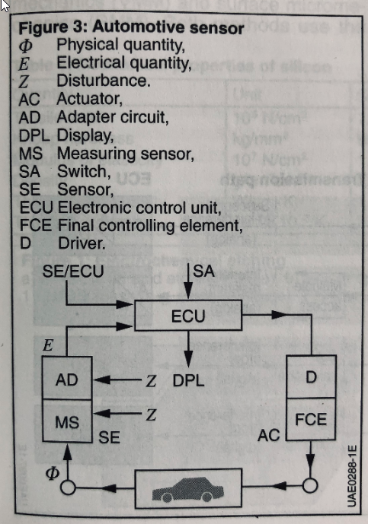
Automotive sensors
Sensor converts a physical or chemical (usually nonelectric) quantities F into electric quantity E.
Sensors classification
  Assignment and application
    Functional
    Safety
    Monitoring
  Type of characteristic curve
    Continuous linear
    Continuous non-linear
    Discontinuous
  Type of output signal
    Current, voltage, amplitude
    Frequency
    Pulse duration

Slide 31
Sensor requirements
Operation conditions(Mechanical Climatic Chemical, Electromagnetic)
Reliability classes
  Steering, brakes, passenger protection
  Engine, driveline suspension, tires
  Comfort and convenience, information, diagnostic, theft detection
Size, miniaturization concepts
  Semiconductor technology (Hall effect)
  Surface and bulk micromechanics (acceleration and yaw sensor)
  Microsystem technology (micromechanical or microoptical system )
Manufacturing cost
Accuracy requirements
Integration level

Slide 32
Basic CE control system
Engine control unit
Diagnostic harness
Check engine light
Throttle position sensor
Mass Air flow sensor
Idle run regulation
Fuel pressure valve
Injectors
Sparking plug
Phase sensor
Detonation sensor
Engine temp sensor
Ignition Module(coil)
The crankshaft position sensor
Oxygen Sensors
Second Oxygen Sensors
Regeneration(Vapor) valve
Charcoal absorber
Fuel filter
Fuel pump/fuel level sensor
catalytic converter

Slide 33
Position and angular position sensors
Measure one or multidimensional displacement and angle positions
  Accelerator / break -pedal position sensor
  Throttle valve position sensor
  Fuel tank level
  Steering wheel angle
Mechanical
  Proportional relationship between the length of a wire or conductive film resistor
Trend to move to wear-free sensors (contactless, proximity sensors)

Slide 34
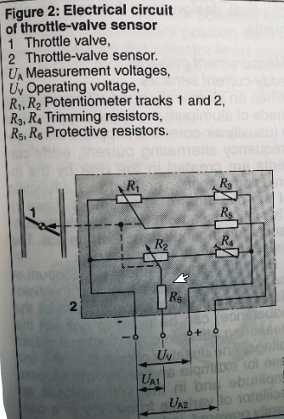
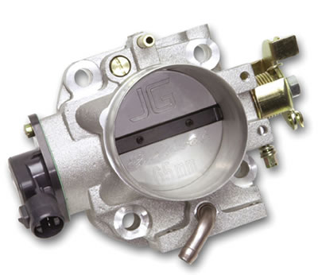
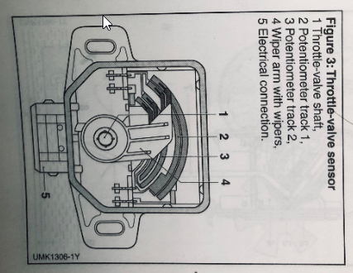
Throttle Position Sensor (TPS)
Variable resister connected to the throttle plate
  Today used electronic throttles
  Only Acceleration pedal has a sensor and throttle plate controlled be DC step motor (used in electronic throttle control (ETC) or "drive by wire" systems)
Variable resister connected to the throttle plate
Today is redundant, only for diagnostic purposes

Slide 35
Wear less sensors
Magnetic inductive sensors -Non contacting position/rotation measurement (AC current)
  Short circuit ring
  Eddy current –when an electric conducting disk approaches a coil supplied with high frequency alternating current , eddy currents are created in disks a function of the distance
  Rotating alternating field
Magnetostatics measures DC magnetic field
  Hall effect
    Switches
    Speed
    Position
  Gaussian effect

Slide 36
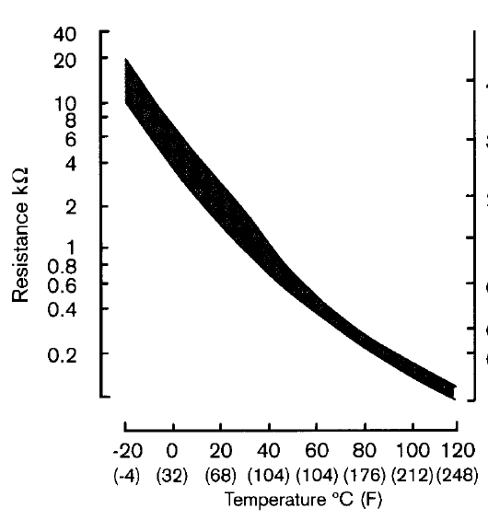
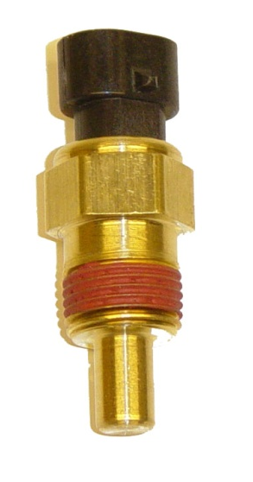
Temperature Sensors
Inlet air temperature sensor
  Measures the temperature of air entering the engine.
  Cold air (more dense) = More fuel for proper AF ratio.
Engine Temperature Sensor
  Monitors the operating temperature of the engine.
  Engine cold = Low Resistance = Rich Mixture

Slide 37
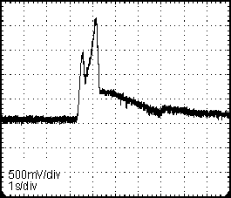
Load sensor (Mass Flowmeters)
Mass flowmeters operate according to the hot-wire or hot-film principle without any moving mechanical part inside the unit
  Can monitor flow variations in the millisecond range.
Measures the amount of outside air entering the engine
  As air flows across it, it cools down The heated wire or film is a positive temperature coefficient (ptc) resistor.
  Adjustments for air temperature and humidity they also affect the temperature of the heated wire or film.
Helps computer to determine how much fuel is needed
Notes:
i=V/R
Cold air has more oxygen …. Temperaturesensor
Drawbacks – inertia….. Gravity……
Manifold Absolute PresureSensor, flexible silicon chip , change valtage based on banding
Accelerate – less vacuum , increase preasue in intake

Slide 38
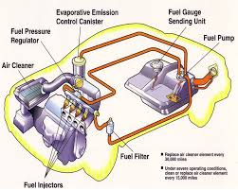
Fuel Injection system
Function :
  Provide a proper amount of fuel for a particular state.
Main Components:
  Fuel tank
  Fuel pump
  Injectors
  Pressure regulator
Single Point Injection systems
  Mono-Jetronic
Multipoint injection systems
  K-Jetronic (KE-Jetronic) -mechanical system which does not require an engine-driven injection pump, pressure injectors
  L-Jetronic (LH-Jetronic) Main controlled variables: air flow and engine speed,

Slide 39
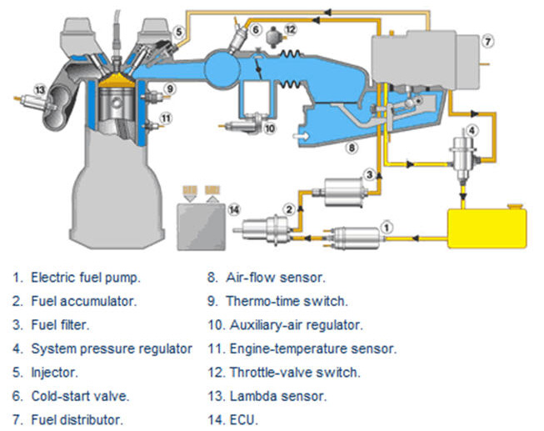
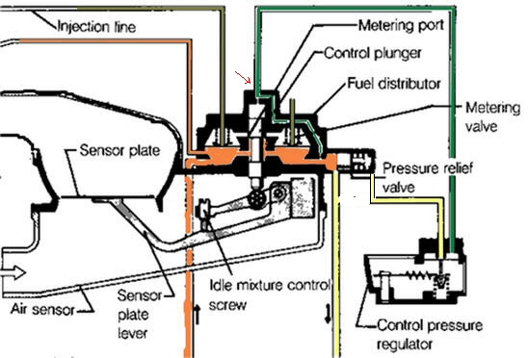
Mechanical systems

Slide 40
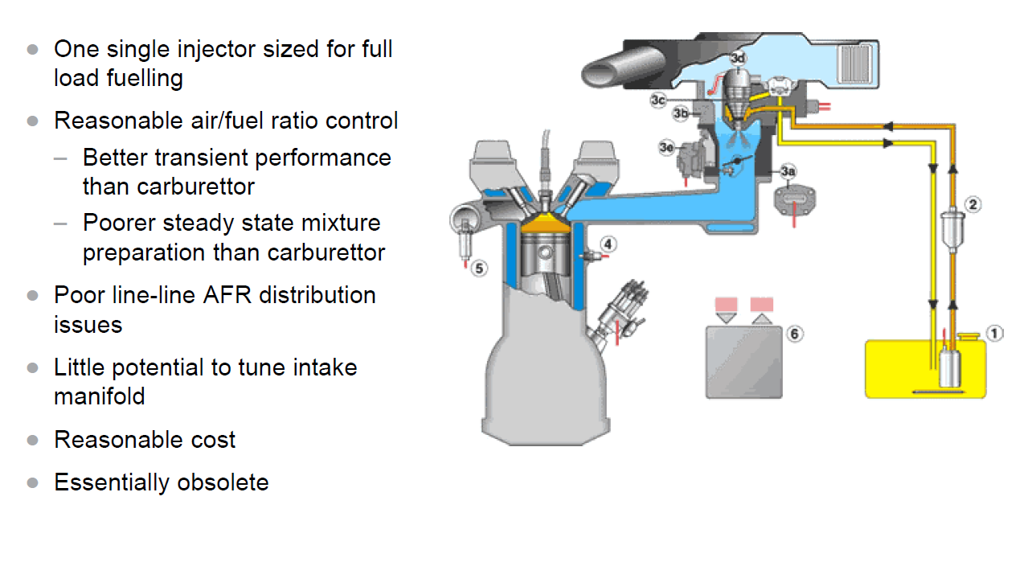
Single point injection system

Slide 41
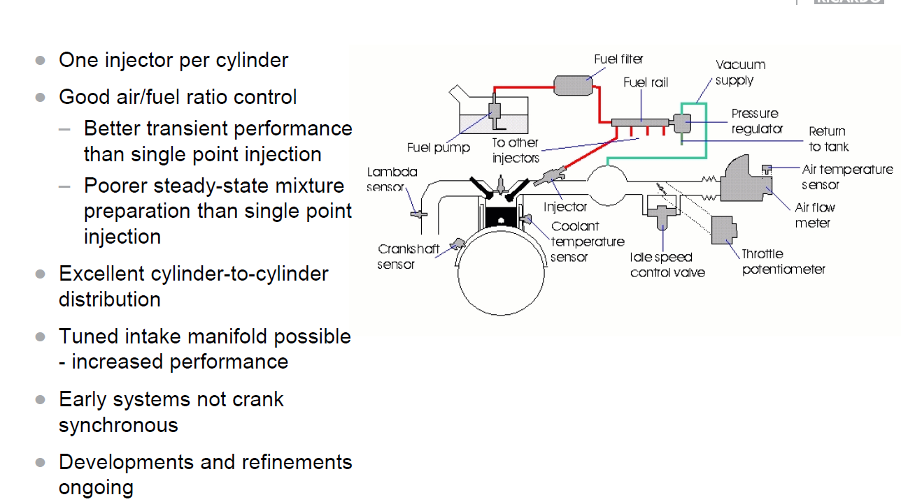
Multipoint Injection System

Slide 42
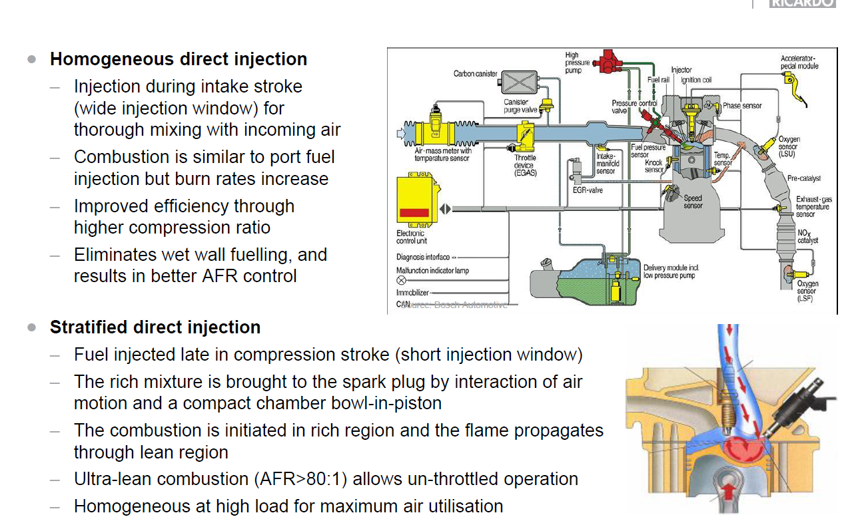
Direct Injection
Notes:
One of the key technologies making gasoline direct injection possible is new piezoelectric fuel injectors. They are extremely precise and extremely fast. They also provide an unexpected side-effect in some cases. With these injectors, it is possible to start a warm engine without using the starter motor. The computer can find a cylinder that has its piston in the right position, inject fuel and fire it to start the engine. This stop-start ability should make it much easier for car manufacturers to create cars that no longer need to idle at traffic lights, saving a lot of fuel (and eliminating lots of urban pollution) in stop-and-go traffic. https://www.seattletimes.com/business/technology/how-gasoline-direct-injection-engines-work/#:~:text=The%20direct%20injection%20process%20allows,can%20increase%20the%20compression%20ratio.
https://www.roadandtrack.com/new-cars/a34054931/pre-chamber-ignition-system-explained/

Slide 43
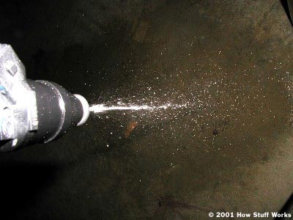
Fuel Injector
Functions:
  Regulate fuel quantity
  Formation of the spray
Fuel injectors serve to meter and atomize the fuel. When the solenoid winding is energized, the nozzle needle is lifted a mere 0.05 mm off its seat.
The injected fuel quantity per unit of time is essentially determined by the system pressure and the free cross-section of the spray orifices in the spray-orifice disk
Injector
1 Pintle, 2 Needle, 3 Armature, 4 Spring, 5 Solenoid winding, 6 Electrical terminals, 7 Fuel strainer.

Slide 44
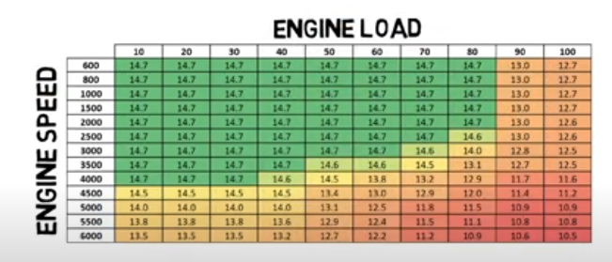
Fuel Injection system Basic principals
The engine control unit uses a formula and a large number of lookup tables to determine the pulse width for given operating conditions. The equation will be a series of many factors multiplied by each other.
Pulse width = (Base pulse width) x (Factor A) x (Factor B)
May have more than 100 parameters, each with its own lookup table.
Some of the parameters even change over time in order to compensate for changes in the performance of engine components.
https://www.youtube.com/watch?v=4FfcjERUtUw

Slide 45
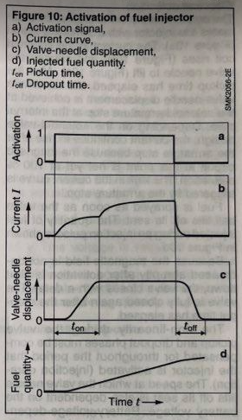
Activation of fuel
Activates with the switch signal
Rissen current cause the needle to lift
Maximum displacement achieved when pickup time is reached
  Needle stops at the solinoid armature stop
Current continues to rice (magnetic field not yet t saturation)
Magnetic field is not decreased abruptly

Slide 46
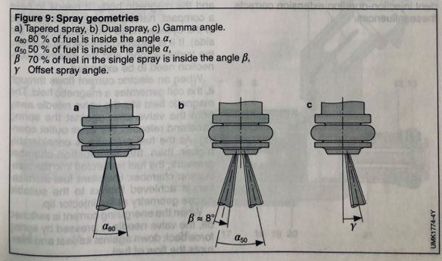
Injection spray geometry
Teraped sprays (for engine with only one intake valve)
Dual spray (two intake valves per cylinder)
Gamma angle (difficult installation conditions, requires spray target)

Slide 47
Ignition Timing
Ignition timing – is a measurement in degrees of crankshaft rotation ,of the point at which the spark is fired in each
Advanced Ignition – ignition before the cylinder reaches Top Dead Center (TDC)
Normal operation -5 deg. BTDC, with increased Engine speed we increase an AI timing
Why to bother:
  fuel does not completely burn the instant the spark fires
  the combustion gasses take a period of time to expand
  time frame for burning and expansion depends on engine speed
Ignition timing affects :
  Engine lifetime
  Fuel economy
  Engine power
Example of cumulative ignition timing consisting of centrifugal and vacuum advance
1 Part-load operation, 2 Full load
Notes:
http://www.youtube.com/watch?v=IYWUWMmimjQ

Slide 48
Sparking plug
Function:
  The spark plug introduces the ignition energy generated by the ignition coil into the combustion chamber
Operation:
  The high voltage creates an electric spark between the spark-plug electrodes
Requirement:
  Function must also be guaranteed under extreme conditions (cold starting, full load)
  ignition voltages of up to 30,000 V
  temperatures in the region of 1000 °C.
Electrode gap
  Should be as large as possible so that the ignition spark activates a large volume element
  Should be be narrow enough to guarantee that the ignition voltage will continue to produce a reliable spark
Spark plug
1 High-voltage connector (terminal nut),
2 Al2O3 Ceramic insulator,
3 Shell,
4 Heat-shrinkage zone,
5 Conductive glass,
6 Captive gasket,
7 Composite center electrode Ni/Cu,
8 Ground electrode.

Slide 49
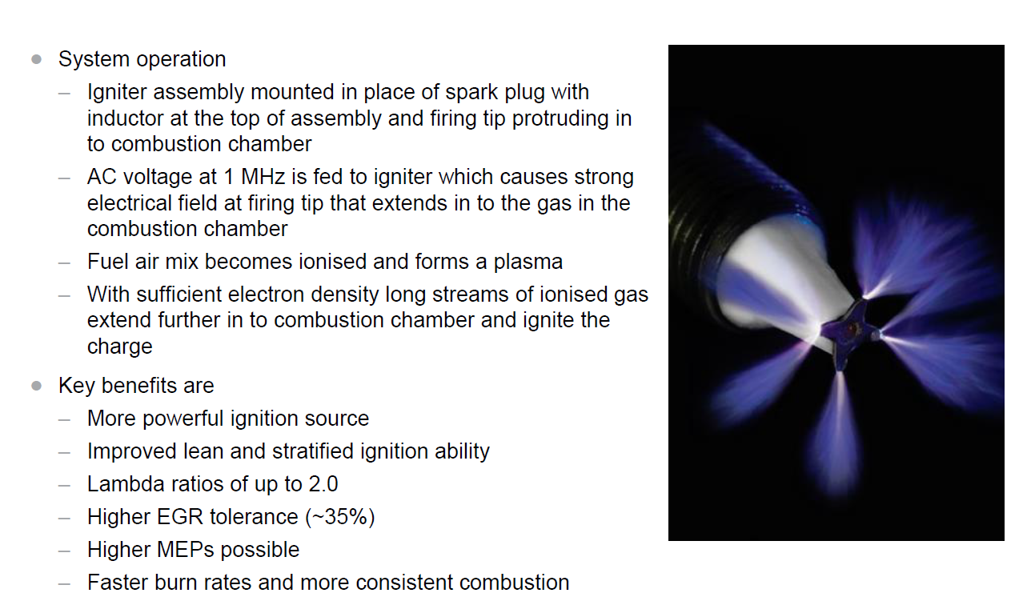
Prototypes Corona Sparking Plug

Slide 50

Ignition system
Deliver Max engine torque - Maximum combustion and maximum combustion pressure occurs shortly after TDP
  Delay between moment of ignition to complete combustion (must occur before)
  Must be advanced
    With the speed of engine increase and charge decreased
    Lean A/F mixture (flame propagates slowly)
AIT determined on the engine test bench and stored in program maps
Other effects can influence ignition timing
  Knock sensors
  https://www.youtube.com/watch?v=oVIrebbfdlA

Slide 51



Effect of ignition timing on exhaust gases and fuel consumption

Slide 52


Functions of ignition system
Determine the timing of ignition
Determine the dwell period (operation timing)
  Ignition energy is depended on the amount of primary current at the moment off ignition cut off
Ignition release
  Ensures that the ignition spark occurs at the right cylinder at the right time and with required energy

Slide 53

Ignition coil
The coil is a high-voltage transformer made up of two coils of wire.
The ignition coil functions:
  Energy-storage device
    energy that is stored in the magnetic field of the core
  Transformer
Primary wiring has much les turns and powered from low voltage batary 12 v
Secondary consists of thousands of turns of smaller wire
Notes:
If you think the coil looks like an electromagnet, you're right -- but it is also an inductor. The key to the coil's operation is what happens when the circuit is suddenly broken by the points. The magnetic field of the primary coil collapses rapidly. The secondary coil is engulfed by a powerful and changing magnetic field. This field induces a current in the coils -- a very high-voltage current (up to 100,000 volts) because of the number of coils in the secondary winding. The secondary coil feeds this voltage to the distributor via a very well insulated, high-voltage wire.

Slide 54


Contact Breaking ignition
Ignition Distributor – replaced by Electric control system
  Centrifugal advance mechanism - adjusts the ignition timing in response to changes in engine speed.
  Vacuum mechanism adapts the ignition timing to changes in engine output and load factor.
  Ignition Distributor - that routes high voltage from the ignition coil to the spark plugs in the correct firing order

Slide 55

Types of Ignition System
Distributorless Ignition Systems
  One coil is used to fire one pair of companion cylinders simultaneously.
Coil-Over-Plug System
  Each cylinder has an ignition coil mounted directly above the spark plug on the cylinder head cover. A short suppressor/connector connects the coil to the plug
Coil-Near-Plug System
  An ignition coil/module is mounted in proximity of each cylinder. There is a short secondary ignition cable that connects the ignition coil and the spark plug. Each ignition coil/module has its own control circuit and is activated sequentially by the PCM.

Slide 56

Evaporative Emission system
Prevents fuel vapor build-up in the sealed fuel tank
Fuel vapors trapped in the sealed tank are vented through the vapor valve assembly on top of the tank
How the system works:
  The charcoal canister temporarily absorbs the HC evaporated from the fuel tank.
  When the engine operates and the purge control valve opens, the absorbed fuel is purged from the charcoal canister and returned to the intake pipe by the negative pressure in the intake pipe.
  The returned fuel is sucked into the engine cylinder together with the fuel injected from the injector and air.

Slide 57


Lambda control
Ensure conversion rate of the catalyzer , must ensure stochiometric ration
Mixture formation is followed up in a control loop
Derivation can be detected by lambda sensors
Typical variation 2 -3 %
Limited control dynamic determined by the sum of response times

Slide 58


Oxygen sensor
Exhaust gas
P_{O′2}
Used to determine air–fuel ratio of a combustion engine is rich or lean
Used to regulate very precisely the air/fuel mixture for combustion to the value lambda = 1
The oxygen sensor is a solid electrolyte made of ZrO ceramic material that becomes electrically conductive for oxygen ions at temperature higher than 300°C.
Voltage output of O2 sensor changes with the change in oxygen content of exhaust
Signal is sent to ECM and the ECM changes the time that an injector is open or close
The sensor does not actually measure oxygen concentration, but rather the difference between the amount of oxygen in the exhaust gas and the amount of oxygen in air
P_{O′′2}
Air
Sensor characteristic curve
0.9
Sensor voltage
0.6
U_{reg}
0.3
0
0.98
1.0
1.02
Normalized A / F ratio

Slide 59

Catalytic Converters
A catalytic converter is a vehicle emissions control device which converts toxic byproducts of combustion in the exhaust of an internal combustion engine to less toxic substances by way of catalyzed chemical reactions.
  carbon monoxide,
  unburned hydrocarbon
  oxides of nitrogen.
Three stages
  The reduction catalyst It uses platinum and rhodium
  to help reduce the NOx emissions
  The oxidation catalyst is the, It reduces the unburned
  hydrocarbons and carbon monoxide by burning
  (oxidizing) them over a platinum and palladium catalyst.
  Control system (second oxygen sensor)

